Slide 1



Slide 2
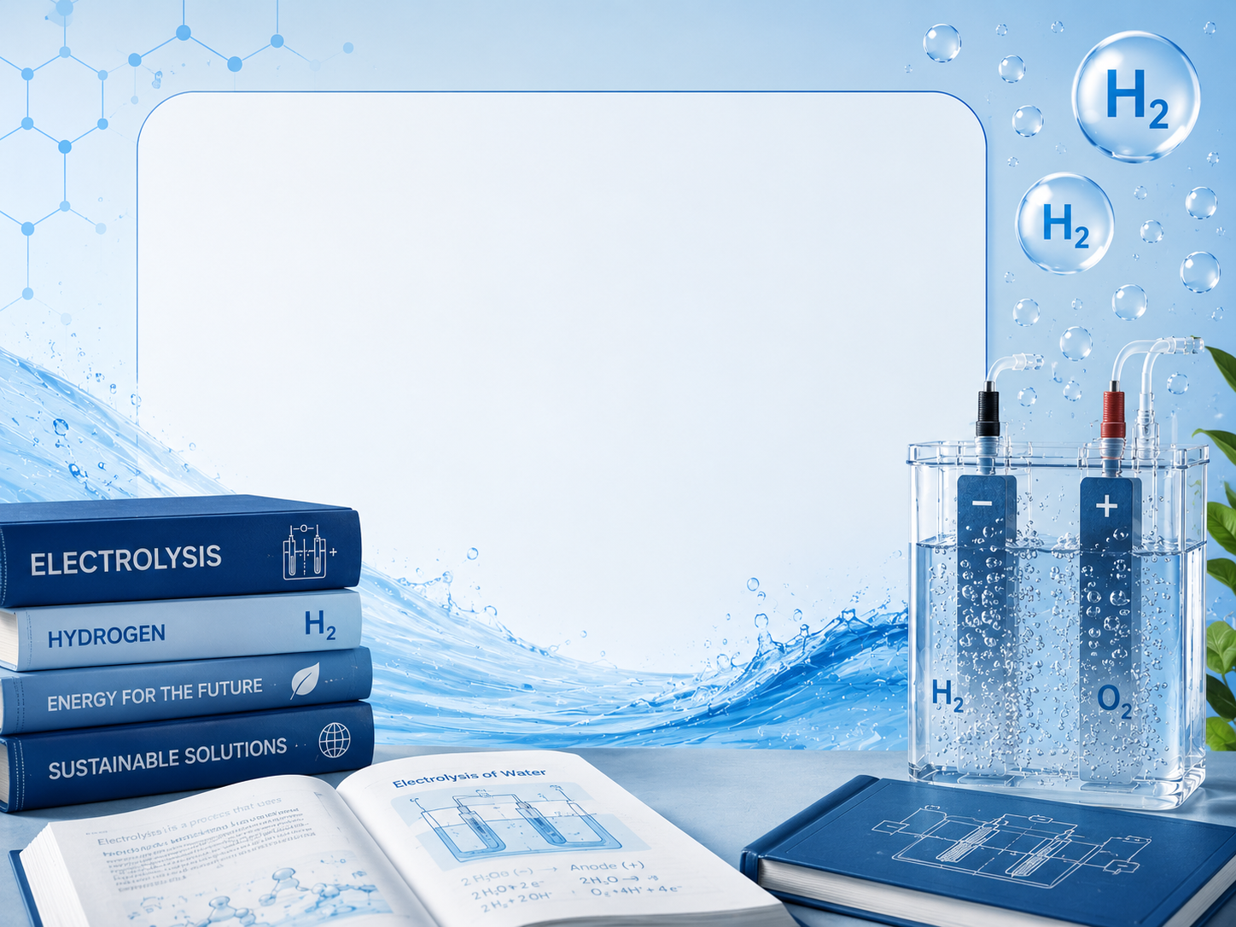
Professional

Slide 3
Everything you need to know about the water electrolysis –
intermediate

Slide 4
Everything you need to know about the water electrolysis –
expert

Slide 5
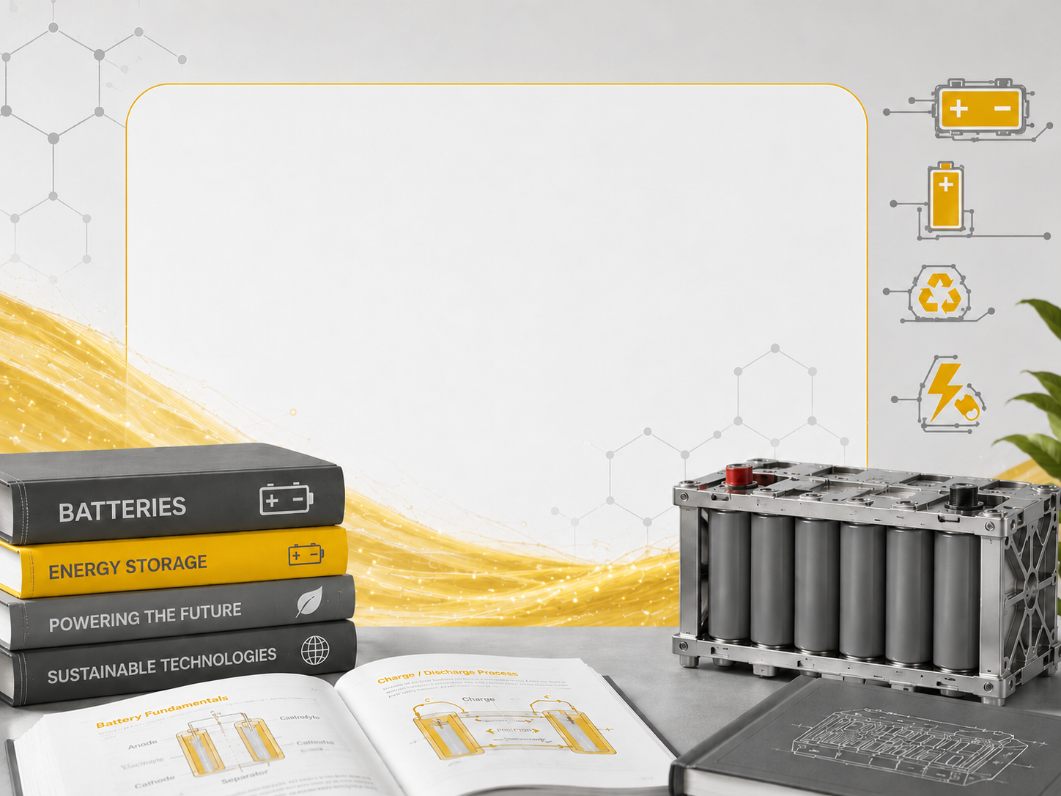
Everything you need to know about the batteries –
beginners

Slide 6
Everything you need to know about the batteries –
intermediate

Slide 7
Everything you need to know about the batteries –
expert

Slide 8
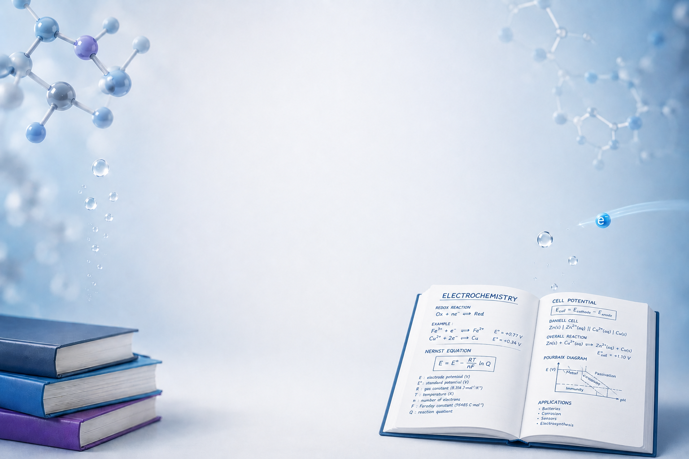
ECLAIR
Professional Training
Fondamentals and Techniques of Electro-Chemistry

Slide 9
ECLAIR
Professional Training
Hydrogen: Electrolysis, Fuel Cells and Industrial Sector

Slide 10
ECLAIR
Professional Training
CO2 : Electro-Reduction and Sustainable Electro-Synthesis

Slide 11
ECLAIR
Professional Training
Batteries and Electro-Chemical Energy Storage

